Slide 1
Final keyword in java
Prepared By: Dimple Bohra

Slide 2
FINAL keyword
In the Java programming language, the final keyword is used in several contexts to define an entity that can only be assigned once.
Final keyword can be used along with variables, methods and classes.
1) final variable
2) final method
3) final class

Slide 3
Final variable
Final variables are nothing but constants.
We cannot change the value of a final variable once it is initialized.
It is good practice to represent final variables in all uppercase, using underscore to separate words.
If final variable is not initialized then it is called as Blank Final Variable.
Final variables can be static as well.

Slide 4
Examples of final variable
final int THRESHOLD = 5; //a final variable
final int THRESHOLD; // a blank final variable
static final double PI = 3.14; // a final static variable PI
static final double PI; // a blank final static variable

Slide 5
Initializing a final variable
We must initialize a final variable, otherwise compiler will throw compile-time error.
There are three ways to initialize a final variable :
You can initialize a final variable when it is declared.
Below are the two ways to initialize a blank final variable:-
A blank final variable can be initialized inside constructor or inside instance initializer block. If you have more than one constructor in your class then it must be initialized in all of them, otherwise compile time error will be thrown.
A blank final static variable can be initialized inside static block.

Slide 6
// instance initializer block for
{
CAPACITY = 25;
}
// static initializer block for
Static
{
EULERCONSTANT = 2.3;
}
// constructor for initializing MINIMUM
public Test()
{
MINIMUM = -1;
}
}
class Test
{
// direct initialize
final int THRESHOLD = 5;
// a blank final variable
final int CAPACITY;
// another blank final variable
final int MINIMUM;
// a blank final static variable
static final double EULERCONSTANT;

Slide 7
When to use final variable
We cannot change the value of a final variable once assigned.
Hence final variables must be used only for the values that we want to remain constant throughout the execution of program.

Slide 8
class TestFinal
{
final int MAX=99;
void myMethod()
{
MAX=101;
}
public static void main(String args[])
{
TestFinal obj=new TestFinal();
obj.myMethod();
}
}

Slide 9

class TestFinal
{
final int MAX=99;
void myMethod()
{
MAX=101;
}
public static void main(String args[])
{
TestFinal obj=new TestFinal();
obj.myMethod();
}
}

Slide 10

class TestFinal
{
final int MAX=99;
void myMethod()
{
System.out.println(MAX);
}
public static void main(String args[])
{
TestFinal obj=new TestFinal();
obj.myMethod();
}
}

Slide 11

class TestFinal
{
final int MAX;
TestFinal()
{
MAX=100;
}
void myMethod()
{
System.out.println(MAX);
}
public static void main(String args[])
{
TestFinal obj=new TestFinal();
obj.myMethod();
}
}

Slide 12
class TestFinal
{
final int MAX;
// TestFinal()
{
MAX=100;
}
void myMethod()
{
System.out.println(MAX);
}
public static void main(String args[])
{
TestFinal obj=new TestFinal();
obj.myMethod();
}
}

Slide 13
When to use blank final variable
Lets say we have a employee class which is having a field called EmpID.
Since EmpID should not be changed once the employee is appointed, we can declare it as a final variable in a class but we cannot initialize EmpID in advance for all the employees.
In such case we can declare EmpID variable as blank final and we initialize this value during object creation.

Slide 14
class EmployeeData
{
final int empid;
EmployeeData (int eid)
{
empid=eid;
}
void myMethod()
{
System.out.println("Employee ID is:"+empid);
}
public static void main(String args[])
{
EmployeeData obj=new EmployeeData (685);
obj.myMethod();
}
}

Slide 15

class EmployeeData
{
final int empid;
EmployeeData (int eid)
{
empid=eid;
}
void myMethod()
{
System.out.println("Employee ID is:"+empid);
}
public static void main(String args[])
{
EmployeeData obj=new EmployeeData (685);
obj.myMethod();
}
}

Slide 16
class Example
{
static final int ROLL_NO;
static
{
ROLL_NO=32;
}
public static void main(String args[])
{
System.out.println(Example.ROLL_NO);
}
}

Slide 17

class Example
{
static final int ROLL_NO;
static
{
ROLL_NO=32;
}
public static void main(String args[])
{
System.out.println(Example.ROLL_NO);
}
}

Slide 18
Final method
When a method is declared with final keyword, it is called a final method.
A final method cannot be overridden.
Which means even though a sub class can call the final method of parent class without any issues but it cannot override it.
We must declare methods with final keyword for which we required to follow the same implementation throughout all the derived classes.

Slide 19
class XYZ
{
final void demo()
{
System.out.println("XYZ Class Method");
}
}
class ABC extends XYZ
{
void demo()
{
super.demo();
System.out.println("ABC Class Method");
}
public static void main(String args[])
{
ABC obj= new ABC();
obj.demo();
}
}

Slide 20
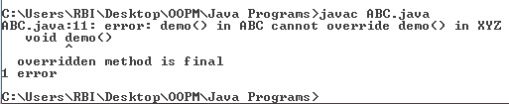
class XYZ
{
final void demo()
{
System.out.println("XYZ Class Method");
}
}
class ABC extends XYZ
{
void demo()
{
super.demo();
System.out.println("ABC Class Method");
}
public static void main(String args[])
{
ABC obj= new ABC();
obj.demo();
}
}

Slide 21
class XYZ
{
final void demo()
{
System.out.println("XYZ Class Method");
}
}
class ABC extends XYZ
{
public static void main(String args[])
{
ABC obj= new ABC();
obj.demo();
}
}

Slide 22

class XYZ
{
final void demo()
{
System.out.println("XYZ Class Method");
}
}
class ABC extends XYZ
{
public static void main(String args[])
{
ABC obj= new ABC();
obj.demo();
}
}

Slide 23
Final class
When a class is declared with final keyword, it is called a final class.
A final class cannot be extended(inherited).
There are two uses of a final class :
One is definitely to prevent inheritance, as final classes cannot be extended.
The other use of final with classes is to create an immutable class.
For example, all Wrapper Classes like Integer, Float etc. and String class are final classes and are immutable too.
Notes:
Immutable class means that once an object is created, we cannot change its content. In Java, all the wrapper classes (like Integer, Boolean, Byte, Short) and String class is immutable.

Slide 24
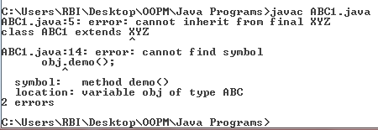
final class XYZ
{
int x=10;
}
class ABC1 extends XYZ
{
void demo()
{
System.out.println("My Method");
}
public static void main(String args[])
{
ABC obj= new ABC();
obj.demo();
}
}

Slide 25
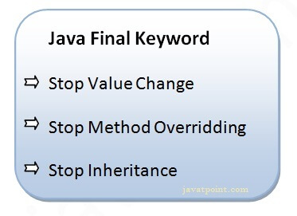
CONCLUSION OF FINAL KEYWORD

Slide 26
Thank you!!!

